Slide 1
Team & Community Building In Your Academy
March 11, 2013

Slide 2
Careers In Education Academy Ygnacio Valley High School
Established in 2001
Currently have almost 140 students
Increased focus on the community aspect of the academy to increase academic achievement:
Beach trip
Field day
Leadership committee
Hired a peer counselor this year

Slide 3
Agenda
Learning Students’ Names
Community Building In The Classroom
5 Elements of Community Building
Team/Community Building Activities
Community Brainstorm

Slide 4
Learning Students’ Names
What's in a name?
Introduce yourself to the group and share any of the following information:
who you were named after
the origin or meaning of your name
what you like or dislike about your name

Slide 5
Community Building in the Classroom
“Students don’t care how much you know till they know how much you care.”
Why is it important to take time for community building?
What are the important elements of community building?
The following are 5 elements considered important when trying to build community…

Slide 6
Elements of Community Building
Through identity – are they part of the classroom environment?
Through familiarity and predictability – do they know what to expect in your classroom?
Through a welcoming environment – including a smile from the teacher
Through trust – do they feel safe in your class? Do you listen to them?
Through family – do you make positive connections with their family/parents?

Slide 7
Build Community
Domino
Man Overboard
Stereotype Walk

Slide 8
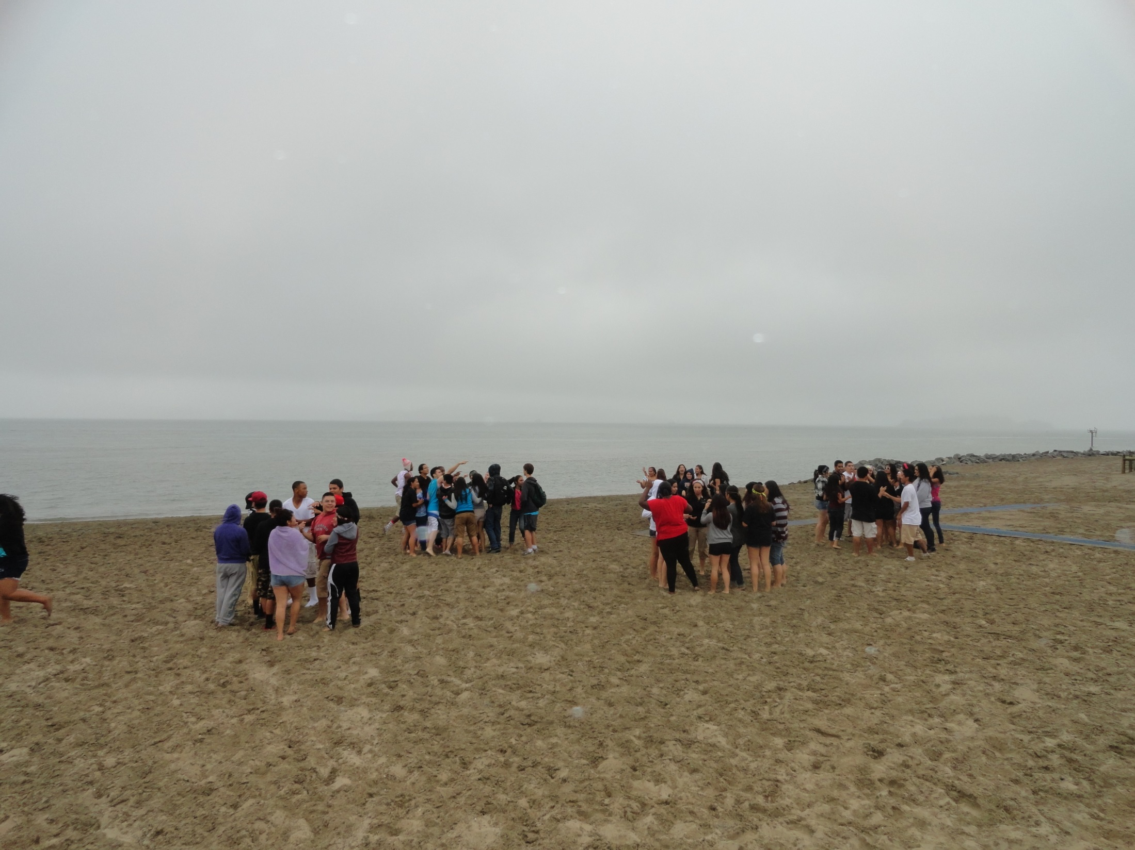
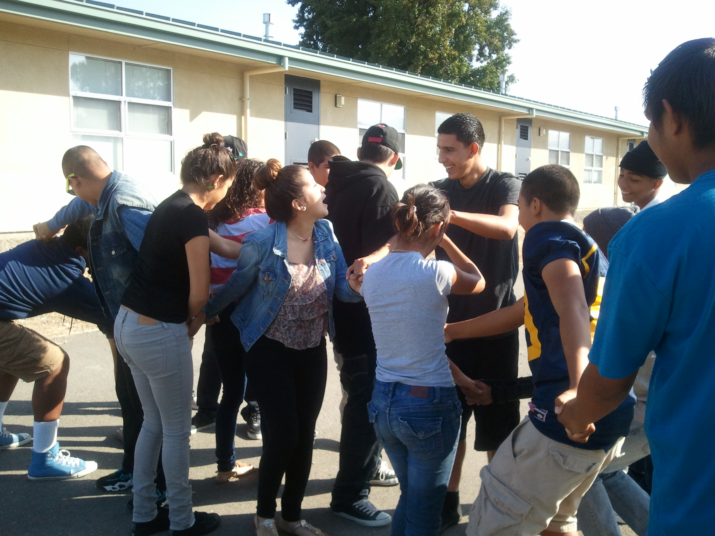
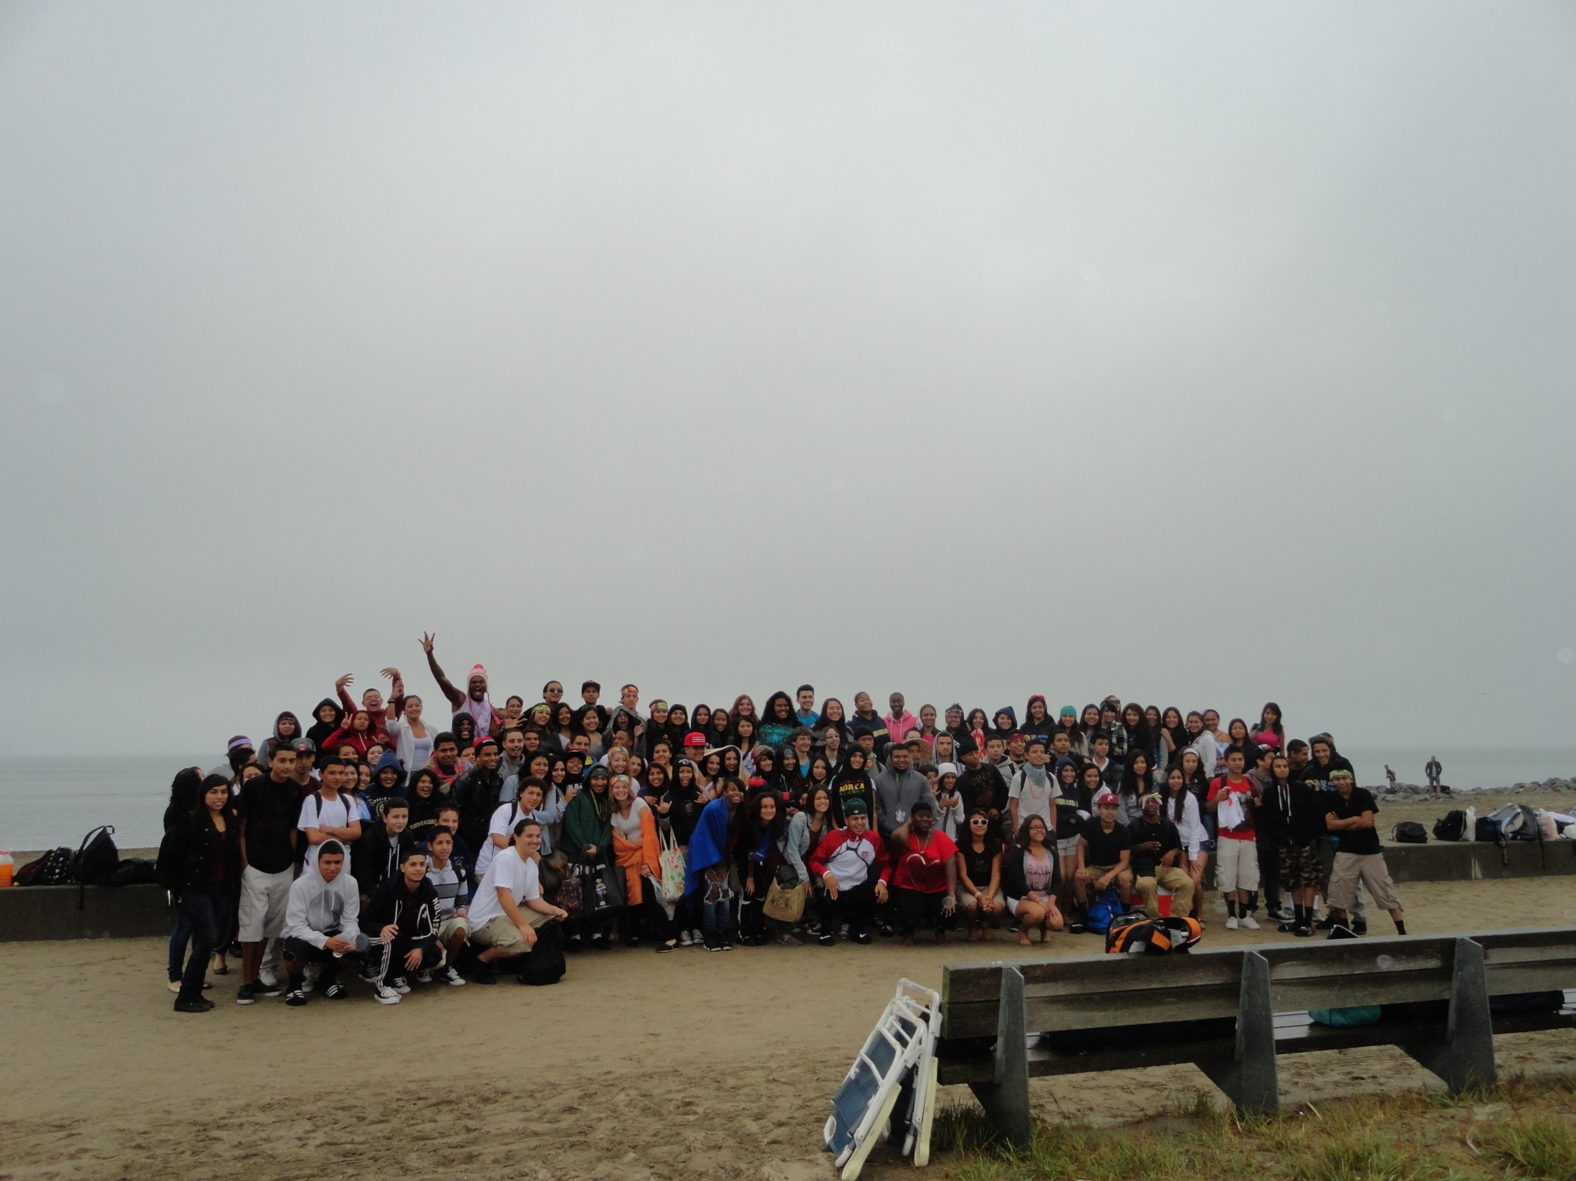
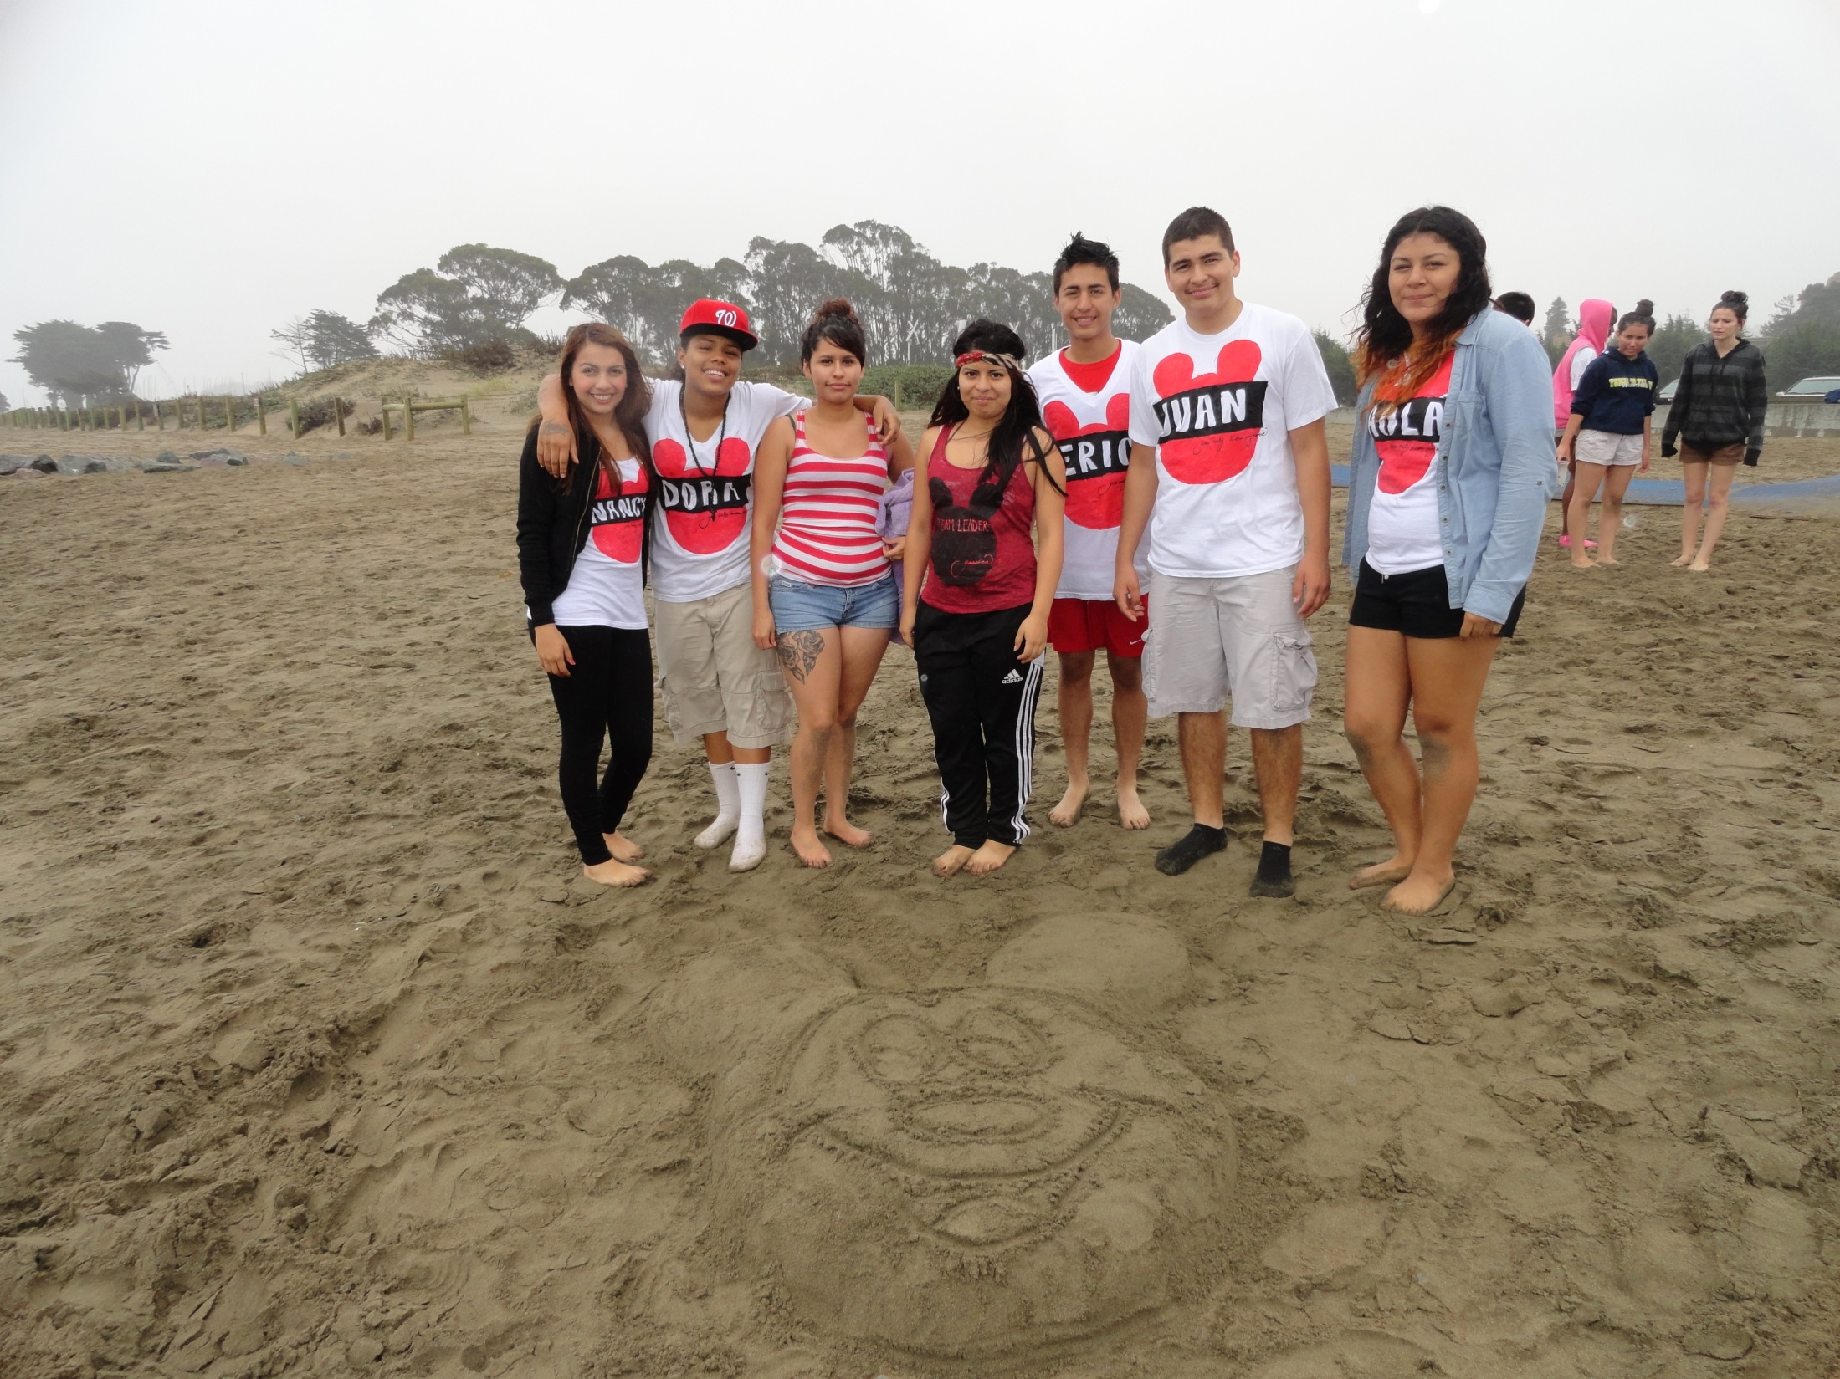
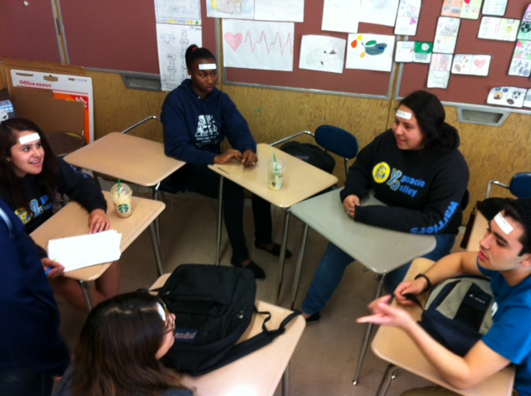
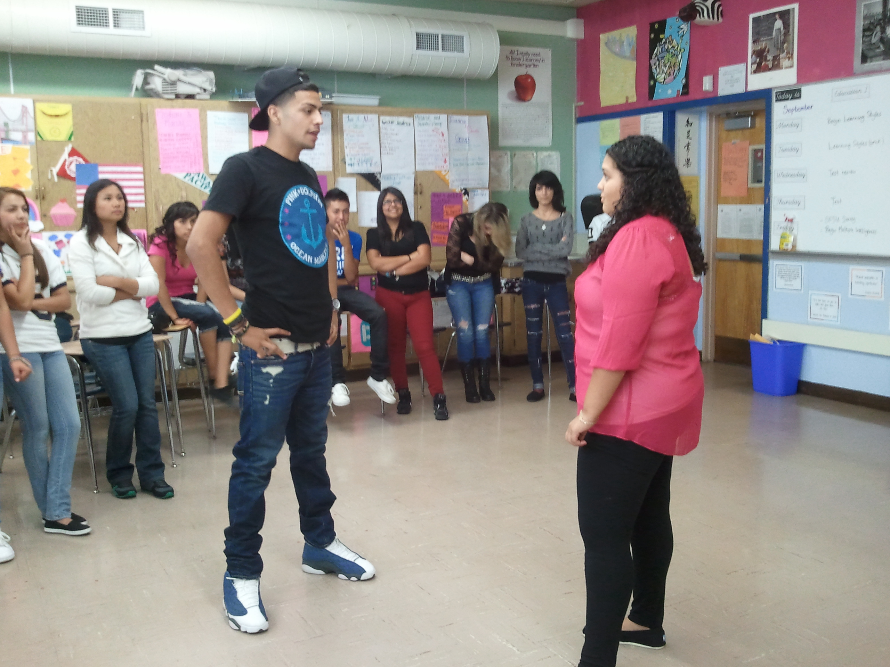
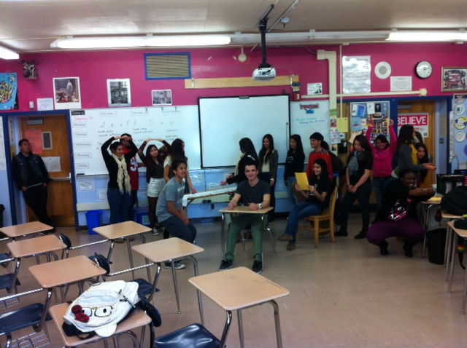

Slide 9
Domino
Draw two things that represent you best.
Once completed connect your domino with someone else who has a similar representation.

Slide 10
Man Overboard
The group mingles around until the leader calls out one of the 6 options:
Bridge = 2 people
Lighthouse = 3 people
Row Your Boat = 3 people
Man Overboard = 4 people
Shark Attack = 5 people
If a person ends up without a partner/team, he/she is a “buoy” and is out of the game
Repeat and have fun!

Slide 11
Stereotype Walk
Disclaimer:
Teachers should be comfortable and known by her/his students.
It is highly suggested that a lesson about discrimination, prejudice, stereotypes and “-isms”, be taught prior to this activity.
Remind students about cultural and emotional sensitivity while keeping an open mind.

Slide 12
Community Brainstorm
In groups of 3 – 4…
Each person share 1 event or activity that their academy does to promote team/community building.
Add to the Community Brainstorm Board

Slide 13
“We cannot plan lessons in hopes that student thinking will shine in an environment where our students do not care about one another.” -Peter Brunn

